Slide 1

CONSULT DR
ExEEd- ACADEMIC SUCCESS
S.NO | Name | Roll No. | Branch & Section
1 | B . Jeevan Jyothi | 21951A0572 | CSE – B
2 | V . Joyce | 21951A0574 | CSE - B
3 | D . Neha | 21951A05B8 | CSE – B
4 | M . Nikitha | 21951A05c4 | CSE – B

Slide 2
Problem Statement
Life is becoming too busy to get medical appointments in person and to maintain a proper health care. The main idea of this work is to provide ease and comfort to patients while taking appointment from doctors and it also resolves the problems that the patients has to face while making an appointment.

Slide 3
Prototype Solution
Today, it is widely recognized that a well-designed healthcare process must provide timely and easy access to healthcare facilities for all patient. Appointment scheduling aims to build an appointment system that optimizes a specific quality standard in a healthcare application of scheduling tasks under uncertainty.We have come up with an android application which acts as a client whereas the database containing the doctor's details, Hospital details and appointment details is maintained by a app that acts as a server.

Slide 4
The "CONSULT DR" has been developed to override the problems prevailing in the practicing manual system. This software is supported to eliminate and in some cases reduce the hardships faced by this existing system. This system is designed for the particular need of the company to carry out operations in a smooth and effective manner.

Slide 5
patient can select a hospital and can view the hospital details.
The patient has the option of selecting a doctor from the list of doctors and can view the doctor's details.
The patient can request for an appointment on his/her preferred day/time.
The selected day/time slot will be reserved and patient will receive the notification of the successfully added appointment.

Slide 6
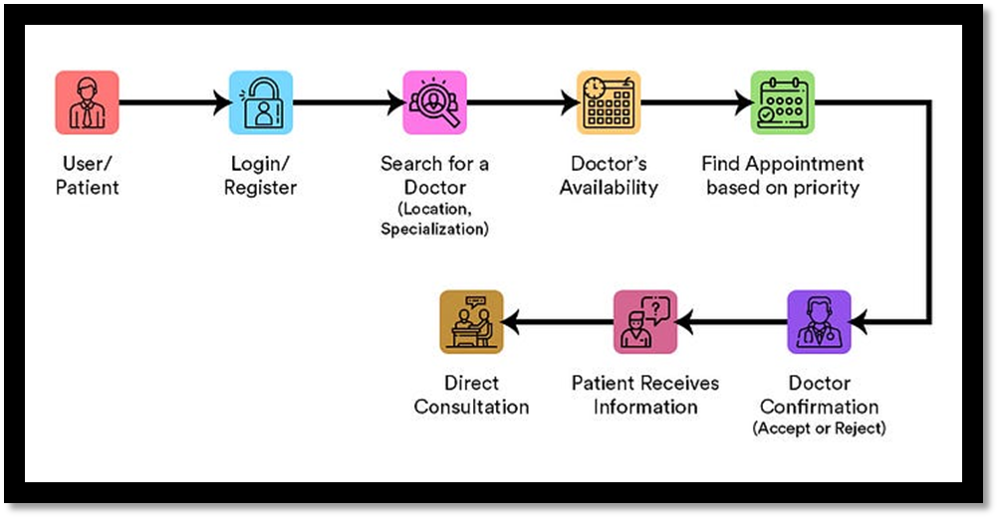

Slide 7
Existing System of Doctor Appointment System: In the existing system the exams are done only manually but in proposed system we have to computerize the exams using this application.
• Lack of security of data.
• More man power.
• Time consuming.
• Consumes large volume of pare work.
• Needs manual calculations.
• No direct role for the higher officials

Slide 8
Proposed System of Doctor Appointment System:
The aim of proposed system is to develop a system of improved facilities. The proposed system can overcome all the limitations of the existing system.
• Security of data and Ensure data accuracy’s.
• Proper control of the higher officials.
• Minimize manual data entry.
• Minimum time needed for the various processing.
• Greater efficiency & Better service.
• User friendliness and interactive.
• Minimum time required

Slide 9
Features
Customizable booking page
Automated SMS
User-friendly and intuitive interface
Automatic reminders
Details of all the hospitals

Slide 10
Tools & Technologies to be used
This project Hospital System has been developed on HTML, CSS, and JavaScript. We are providing html project ideas and also html projects with source code.
The main objective of developing this project was to create a static app for the Hospital, from which user can get the details of the hospital, such as about the hospitals, contact details, address, images etc.

Slide 11
The back-end looks similar to a dashboard that displays all your booking records
Java
C
Python
SQL

Slide 12
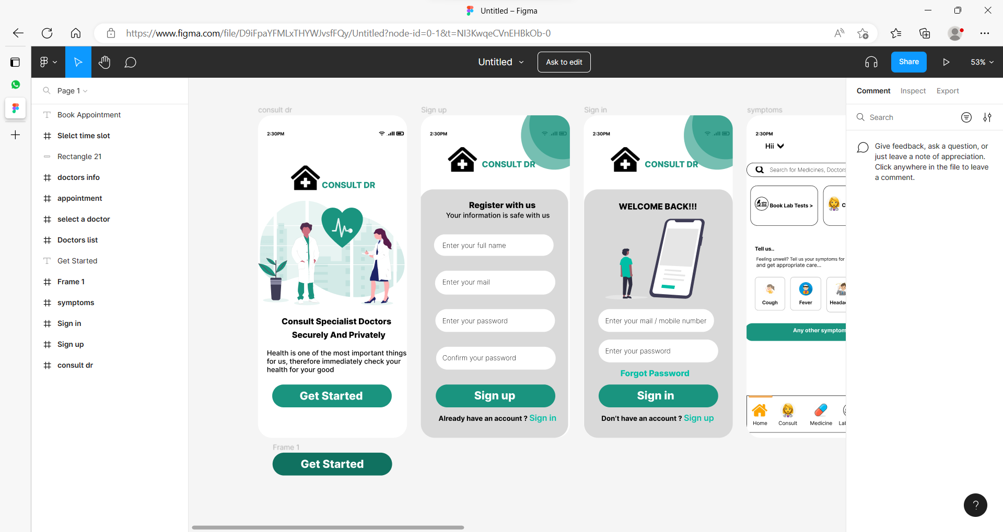
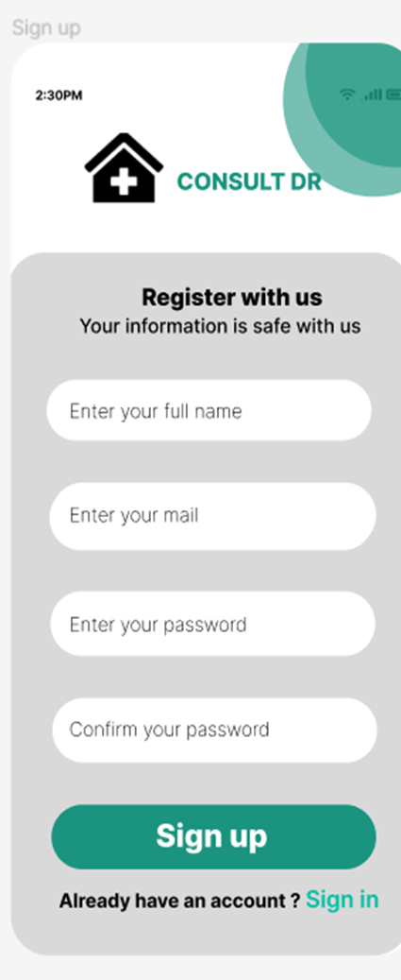
Prototype pictures

Slide 13
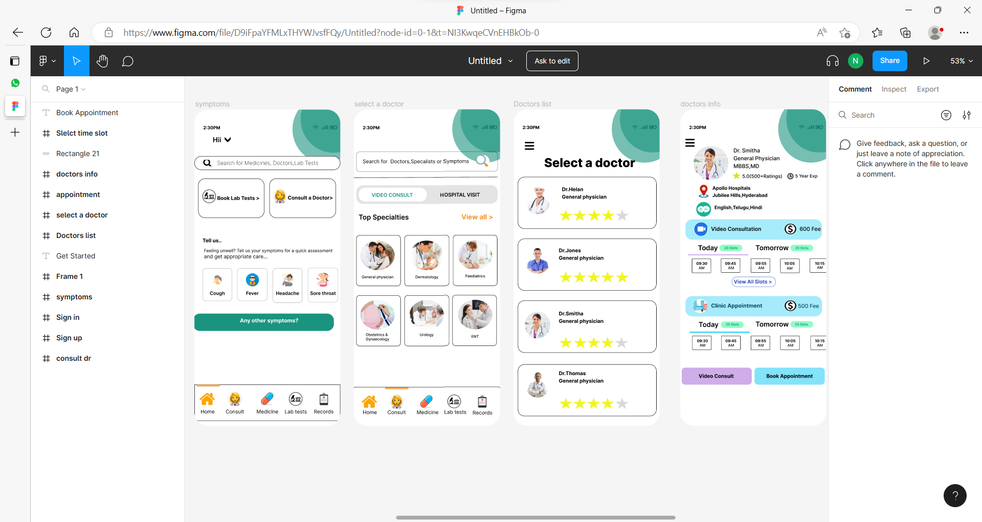

Slide 15
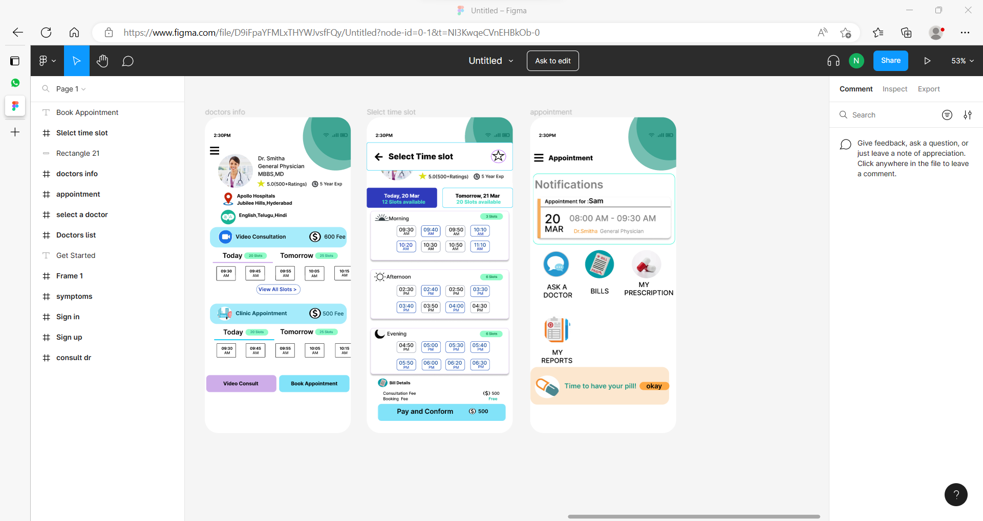

Slide 17


